Slide 1

Presenting our training courses available that meet your needs!
https://consultglp.com
…working towards meeting the ISO/IEC 17025:2017 requirements

Slide 2
Our ultimate aims of training courses
Upon completing each of our workshops / courses, the participants will:
  leave the class room with satisfaction
  have gained confidence in grabbing the concepts of the elements learned
  be able to start applying the practical concepts in their routine works

Slide 3
Characteristics of our training courses
Readable training materials which become a good source of future reference
Conducting hands-on class exercises after studying worked examples
Worked examples of in-house courses can be tailored to the specific requirements of your organization
Mastering the applications of statistical methods for test and calibration laboratories in plain language
Free sharing of our relevant MS Excel ® worksheet templates
Free on-line consultation on related issues after training
More importantly, sharing our 40–year practical experiences in laboratory quality management ideas

Slide 4
Essential ISO/IEC 17025 requirements
Understanding basic statistics
Measurement uncertainty evaluation
Method validation techniques
Internal audit techniques
Risk-based thinking
Decision rules determination
Our main training courses at a glance
Enquiries are welcome!
guanhuah.yeoh@consultglp.com

Slide 5
Topics covered….
Basic statistical tools
  Measurement errors
  Understanding terms related measurement uncertainty
  Population and samples
  Central limit theorem; sampling theory
  Student’s t-distribution
  Probability distribution functions
  Hypothesis testing – F, t-tests
  ANOVA (one-factor and two-factor)
  Linear regression
  Constructing quality control charts
Measurement uncertainty (MU) evaluation for test laboratories
  What and why?
  Law of propagation of uncertainty
  Component-by-component approaches:
    GUM (Bottom-up) methods
    Top-down methods
      Repeatability, reproducibility & trueness
      Quality control chart
  Detailed MU evaluation of each step of analytical procedure
  Full worked examples, including microbiological counting

Slide 6
Topics covered….
Method validation (MV) techniques
  What and why?
  ISO/IEC 17025 requirements
  Validation and verification
  Strategies to conduct a MV study
  Essential elements included:
    Specificity & sensitivity
    Precision, accuracy and trueness
    Range and linearity
    Detection limits (IDL, MDL, LOQ)
    Robustness and ruggedness
    Measurement uncertainty
  Evaluation of data and monitoring
Internal audit techniques
  Understanding the elements of ISO/IEC 17025:2017 standard
  Importance of internal audits
  Types of internal audits
  Planning of internal audits
  Internal audit approaches – horizontal and vertical
  Procedures of conducting an internal audit
  Elements of a laboratory internal audit using a check list
  Preparation of audit findings and reports
  Common non-conformities found in laboratory auditing

Slide 7
Topics covered….
Decision risk and rule for conformity assessment
  Reviewing hypothesis testing
    Type I and Type II errors
  What is conformity testing?
  Relevant clauses of the ISO standard
  Issues on making a statement of conformity and risk involved
  Basic theory of making a decision rule
  Setting a guard band for decision risk control
  How to present your decision rules to your clients
  Worked examples
Risk-based thinking and risk assessment
  Requirements under ISO standard
  What are the risks and opportunities in an accredited laboratory
  Risk assessment methods – qualitative and quantitative
    Risk identification & evaluation
    Risk analysis
    Risk response, control and monitoring
  Sharing real life worked examples

Slide 8
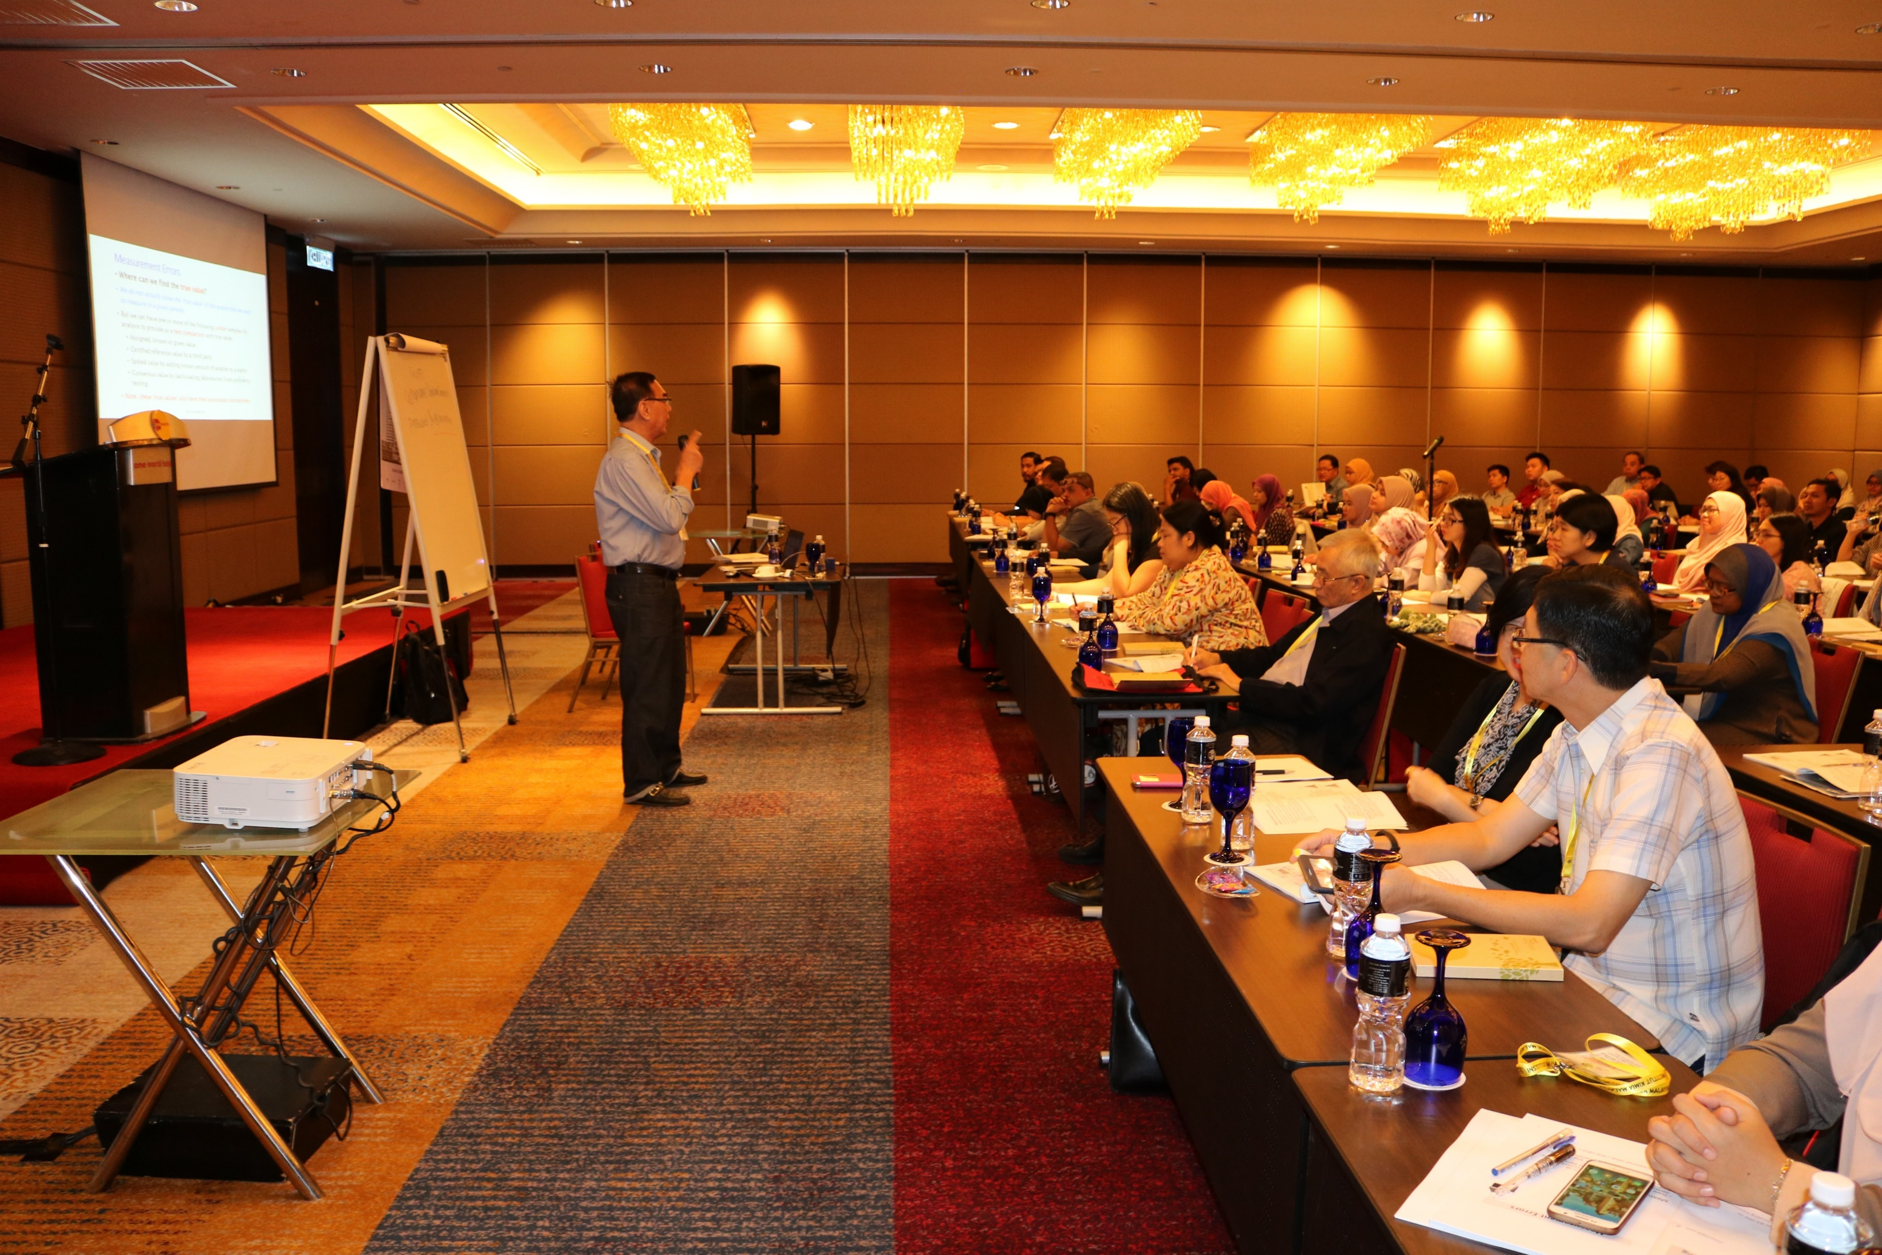


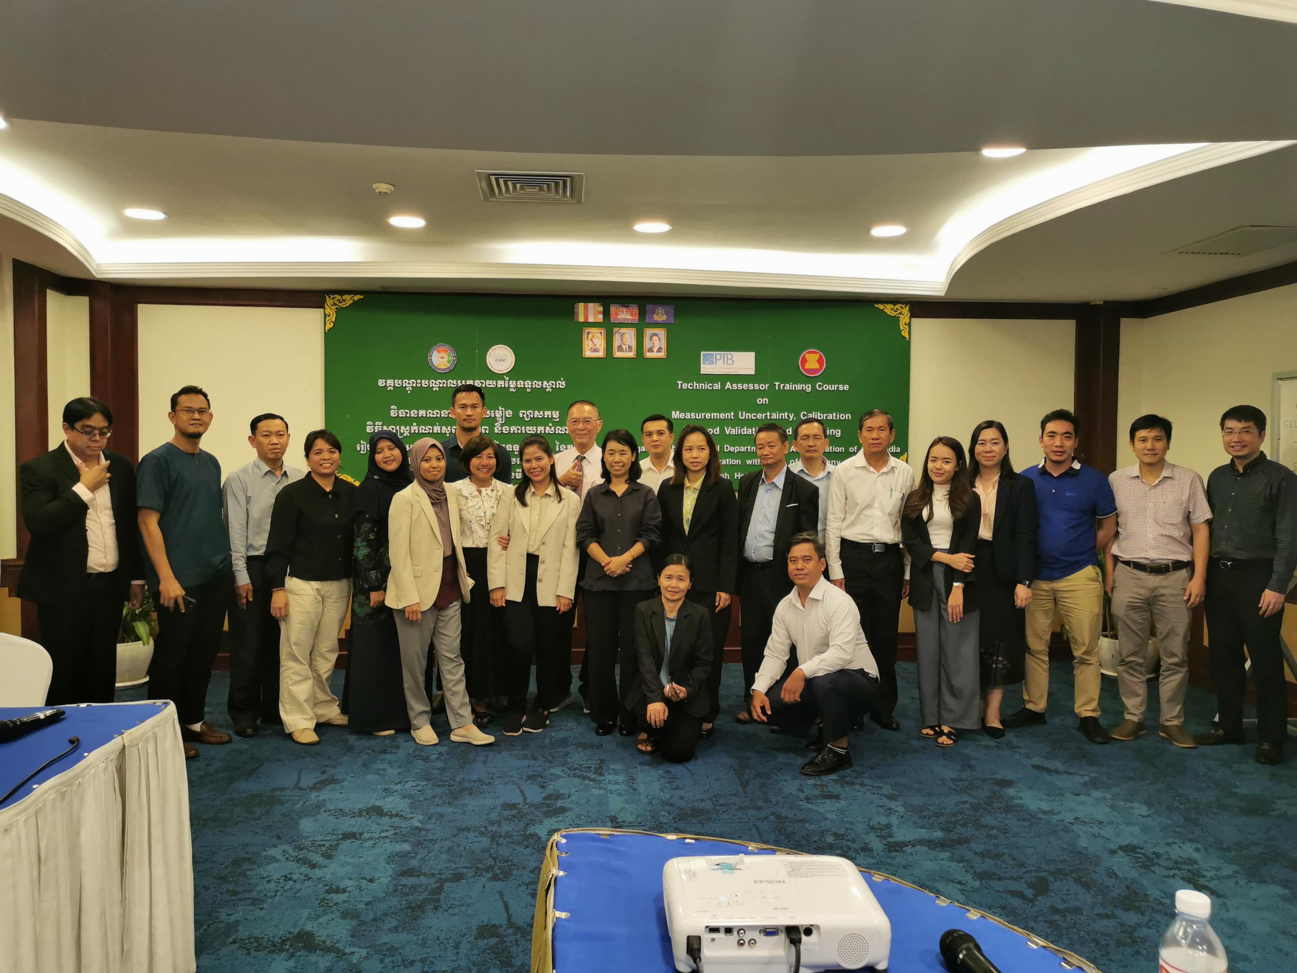
From our photo files ….

Slide 9
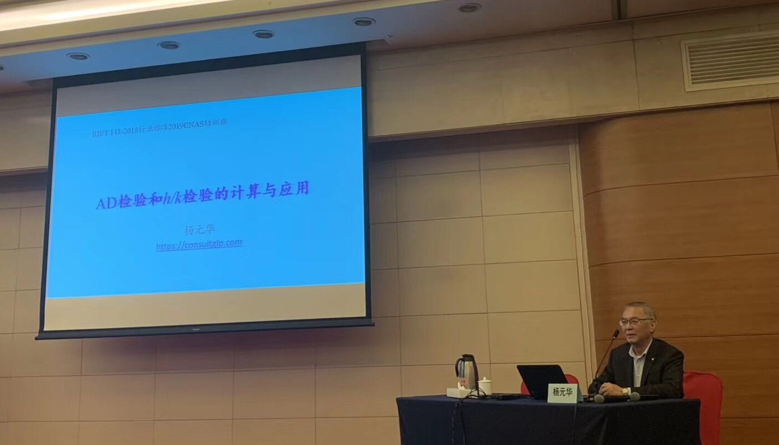
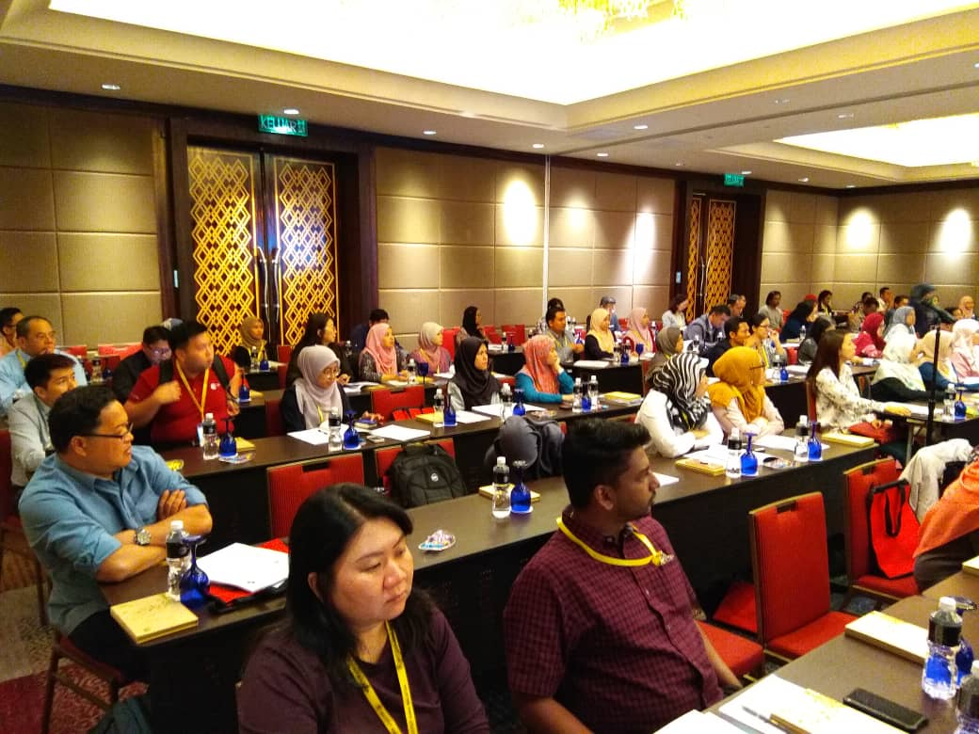
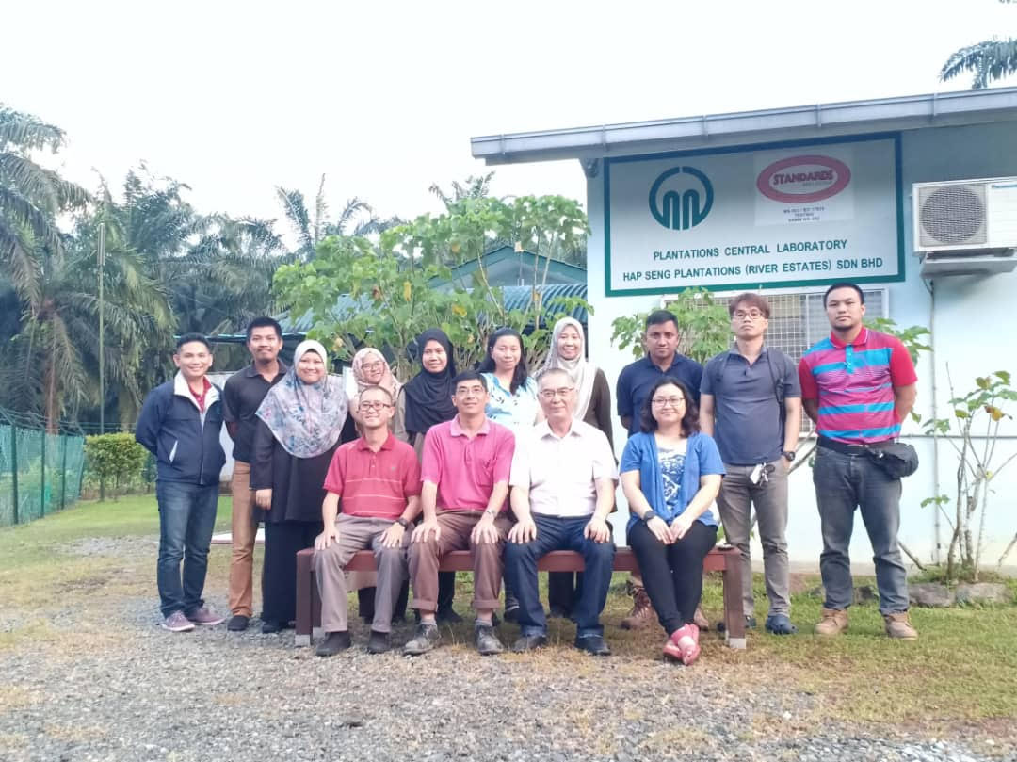

From our photo files ….

Slide 10
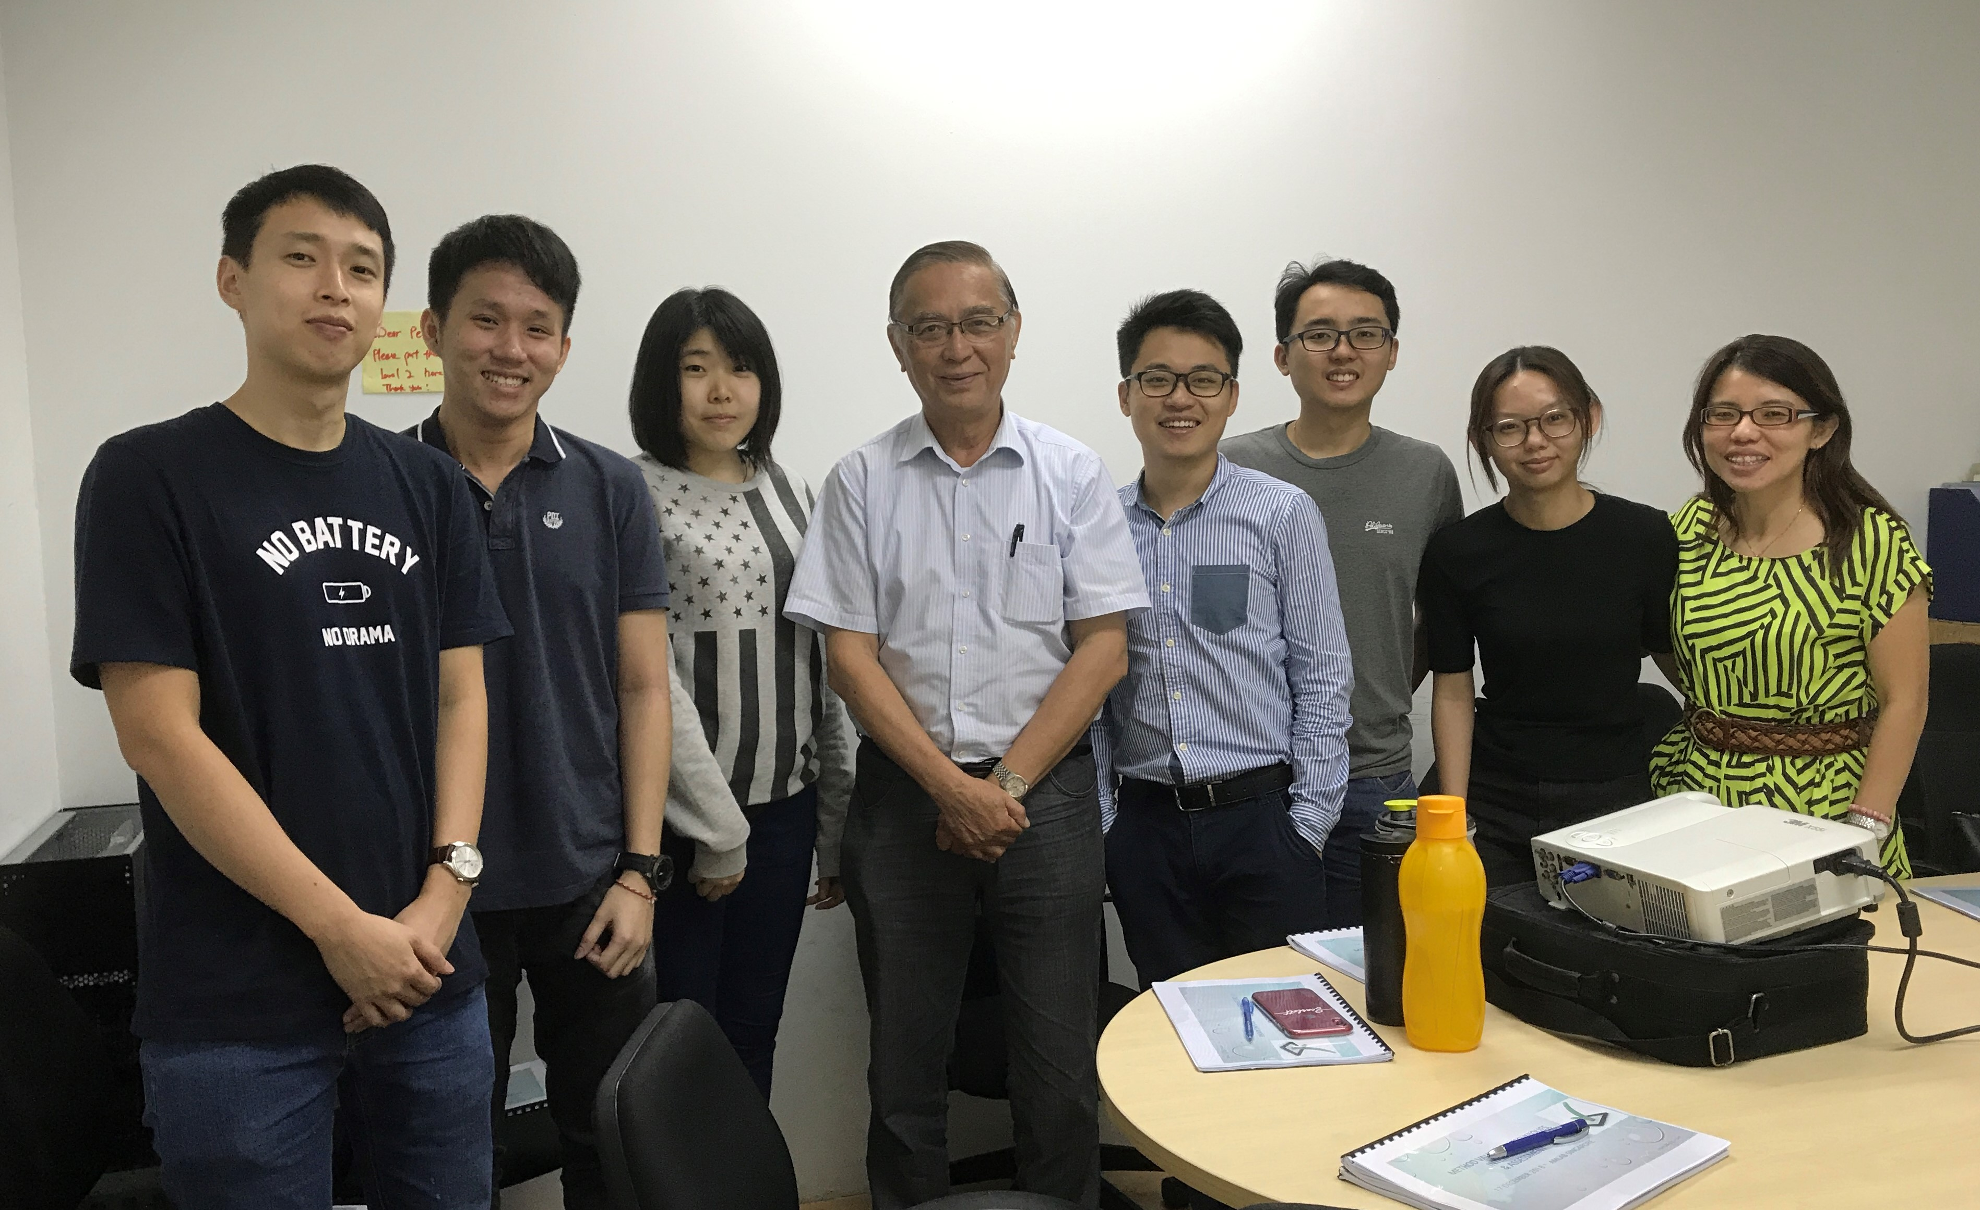
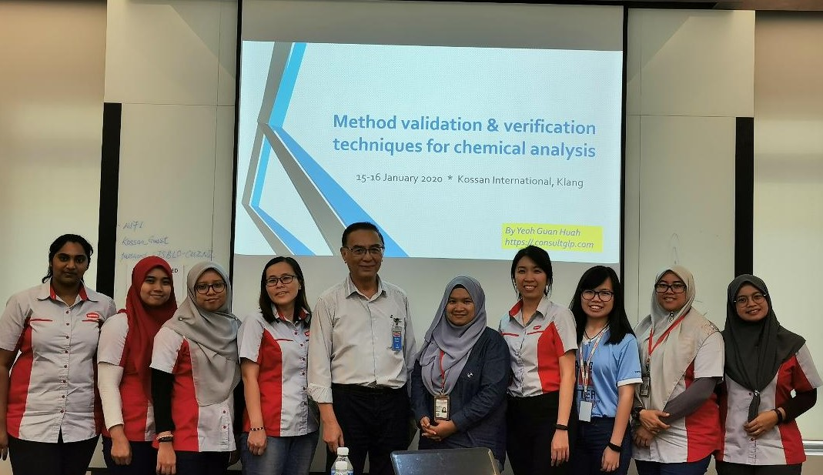
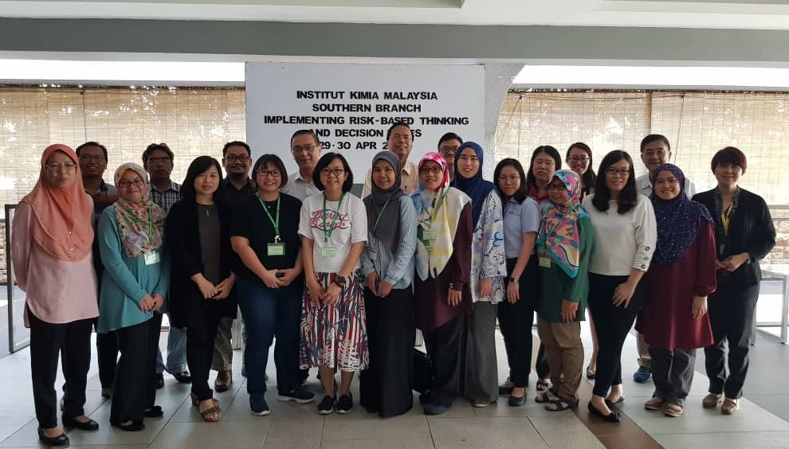
From our photo files ….

Slide 11
Thank you for viewing!
For enquiries and more information, please write to: guanhuah.yeoh@consultglp.com
https://consultglp.com

